Slide 1
Cleaner bills, cleaner air: the environmental consequence of Renewable Portfolio Standards (RPS) policy design
Xinde James Ji, University of Florida
Qingran Li, Clarkson University
Filippo Mavrothalassitis, Yale University
Max Luke, National Economic Research Associates

Slide 2
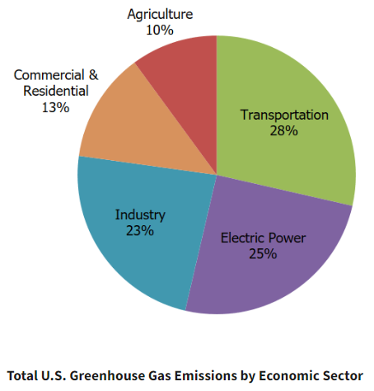
Motivation
Climate change is one of the most important challenges facing our future
The US lacks a federal overarching climate policy (e.g. carbon tax) and instead implements sector-wise policies
Transportation: CAFE standards, LCFS
Buildings: energy efficiency policies, e.g. building codes, appliance standards
Power: Renewable Portfolio Standards (RPS)
The power sector decarbonization is essential for low-carbon economy.
25% of GHG emissions in 2021 (down from 32% in 2001)
Integrated with other sectors through electrifications (EVs, heating)
Source: EPA (2021) https://www.epa.gov/ghgemissions/sources-greenhouse-gas-emissions

Slide 3
What is Renewable Portfolio Standards (RPS)?
RPS is a state-level policy that requires a specific percentage of electricity sales from renewable resources
36 states + DC have passed RPS policies as of 2021

Slide 4
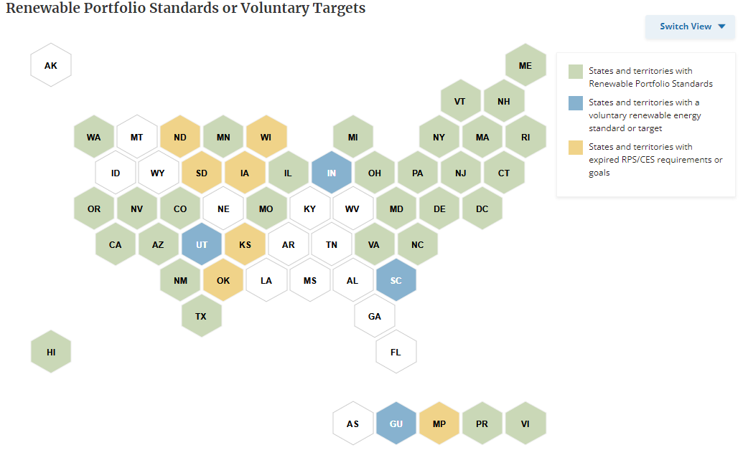
RPS policies: status quo (36 states + DC)
Source: National Conference of State Legislatures (2021). https://www.ncsl.org/energy/state-renewable-portfolio-standards-and-goals

Slide 5
What is Renewable Portfolio Standards (RPS)?
RPS is a state-level policy requiring a specific percentage of electricity sales from renewable resources
36 states + DC have passed RPS policies as of 2021
RPS vs. Clean Energy Standard (CES)
“Clean Energy” can include nuclear which is non-renewable.
This study treats them as the same policy.
Policy goals of RPS:
Energy independence/diversification
Carbon mitigation
Non-GHG pollution is NOT part of the legislative intent for most RPS

Slide 6
Empirical evidence on the impact of RPS
Recent causal evidence suggests that RPS policy:
Increases retail electricity price by 2-11% (Upton and Snyder 2015; Greenstone and Nath, 2021; Wolverton et al. 2023)
Decreases carbon emission by 10-25% (Greenstone and Nath, 2021)
RPS is relatively cost-ineffective as a climate policy: $60-300 per ton of CO2 abatement
Small increases in renewable energy deployment (Greenstone and Nath 2023; Fullerton and Ta 2022; Feldman and Levinson 2023; Deschenes et al. 2023)
Large reductions of in-state and out-of-state coal generation (Hollingsworth and Rudik 2019)

Slide 7
Less clear in the literature: environmental effects of RPS
In theory renewable energy provides non-climate environmental benefits
Empirical evidence is scarce, many based on simulation (Johnson and Novacheck 2015; Barbose et al. 2016; Wiser et al. 2017)
Model potential change in energy mix – project corresponding change in flow pollution emission
Co-benefit ~$1.5 billion annually
Closest empirical evidence: Hollingsworth and Rudik (2019 JAERE):
Models REC demand at state/facility levels
Simulate pollution reduction, then monetize using Mueller et al.(2013)’s air pollution transport model
Co-benefits from $100,000 to over $100 million with 1% increase in nominal RPS target

Slide 8
Policy design matter: the role of policy stringency
RPS laws can differ widely from each other (Carley et al. 2012; Fischlein and Smith 2013; Bernstein and Hoffmann 2018; Carley et al. 2018) in a variety of ways:
Percentage requirement (nominal goal)
Design features: multipliers, exemptions, voluntary goals etc.
Limited evidence that systematically documents stringency and its impacts
Carley et al. (2018 Nature Energy): more stringent laws lead to higher renewable adoption with a mixed quantitative-qualitative scoring system
DSIRE database (NC State): a database on RPS stringency but does not enable structured comparisons of technology types
Hong et al. (2023 NBER WP): Exempted municipal generation facilities are less constrained financially compared to commercial counterparts

Slide 9
What’s this study about?
Construct a new, unified metric of RPS stringency
Provide causal estimates on the heterogenous environmental effects of RPS:
Pooled together, on average RPS mildly reduces SO₂ emission and has negative but insignificant effects on NOx emission or ambient air quality
The RPS effect differs widely by policy stringency:
States with “clean” RPS laws: Large reductions in SO₂ and NO_{x} emission, improvement in ambient air quality
States with “dirty” RPS laws: Small reduction in SO₂, no reduction in NO_{x} emissions, no ambient air quality improvement
Effects driven by differential shifts in generation sources
States with clean RPS laws transit away from coal faster

Slide 10
Contributions to Literature
On causal identification of the heterogenous impacts of RPS
Previous studies mostly focused on impacts of renewable adoption, GHG emission, and price effects (Upton and Snyder 2015; Carley et al. 2018; Greenstone and Nath, 2021, etc.)
We document the heterogenous environmental impact of RPS (Hollingsworth and Rudik, 2019)
Environmental federalism and policy stringency
We document the performance gap in policy design heterogeneity in RPS (Lyon and Yin 2010; Carley et al. 2012, 2018; Hong et al. 2023)
Compliment studies on hazardous wastes (Soberg and Xu 2018; Blundell et al. 2021); wetlands (Keiser et al. 2022; Aronoff and Rafey 2023); pollution monitoring and enforcement (Zhang 2018)
Co-benefits and unintended consequences of environmental policy
We document large non-carbon co-benefits generated from a renewable energy policy
Literature on co-benefits of sulfur cap-and-trade (Stavin and Schmalensee 2013); non-point-source water pollution (Keiser et al. 2019; Weng et al. 2023);

Slide 11
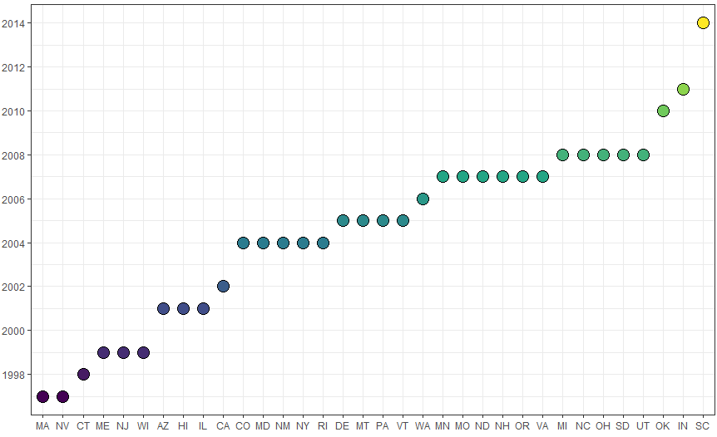
Staggered Treatment: RPS legislation years
RPS states are defined as states passed RPS policies before year 2012.
Our analyses exclude 4 states that had RPS between 1990-2012:
West Virginia repealed its RPS in 2015.
Iowa and Texas set RPS targets in terms of renewable capacity levels rather than % of retail electricity sales.
Kansas requires a percentage of peak electricity demand.

Slide 12
Documenting discrepancy in policy design
Voluntary Goal: States set a voluntary renewable/clean energy goal instead of a mandatory standard.
Excluded Sales: RPS targets apply to only a subset of load serving entities (LSEs), and/or some obligated LSEs are allowed to exclude a portion of their load from determination of their annual procurement obligations.
Credit Multipliers: Many states allow the use of credit multipliers for certain types of resources and/or allow demand-side management resources to contribute to some portion of the RPS.
Carbon Exemption: States allow carbon-emitting technologies to be counted as “renewable” energy

Slide 13
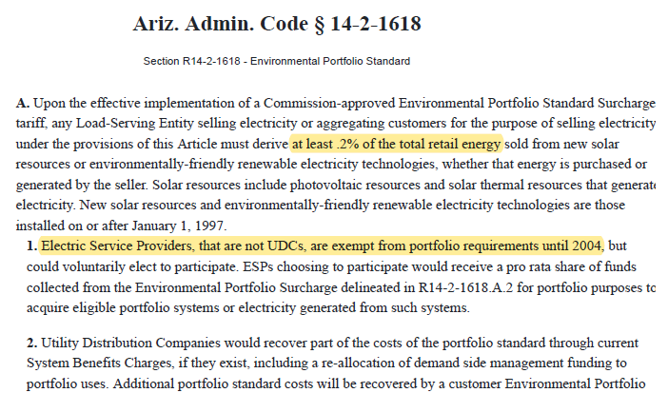
“Excluded Sales” example: Arizona (2001)

Slide 14
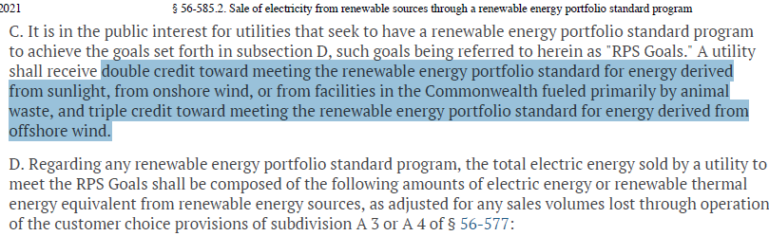
“Credit Multipliers” example: Virginia (2007)

Slide 15
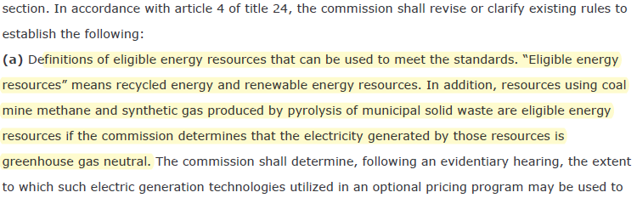
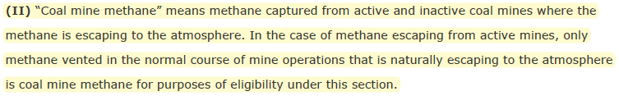
“Carbon Exemption” example: Colorado (2004)

Slide 16
The RPS Statues Database
We collect all RPS laws passed until 2018
Record the nominal goal and the target year
Quantify the minimum amount of renewable energy needed to achieve the nominal goal
Subtract four types of discrepancies from the nominal goal
Resulting in the binding minimum metric

Slide 17
AZ’s RPS laws
AAC R14-2-1618 (2001): Environmental Portfolio Standard
Nominal target: 1.1% of sales by 2006
Excluded amount: 41.72% of the target
Multiplier discount: 50% of the target
Binding target: 0.09% of sales by 2006
AAC R14-2-1801 et seq.: Renewable Energy Standard and Tariff
Nominal target: 15% of sales by 2025
Excluded amount: 1.97% of the target
Multiplier discount: 20% of the target
Binding target: 11.70% of sales by 2025

Slide 18
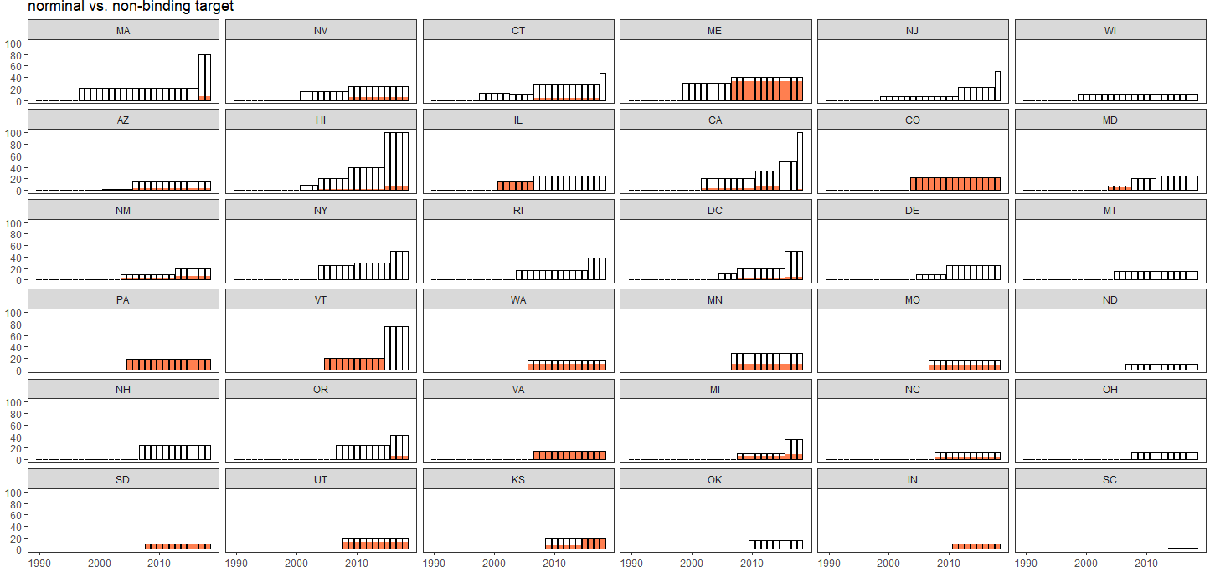
Policy discrepancy led to “non-binding” commitment

Slide 19
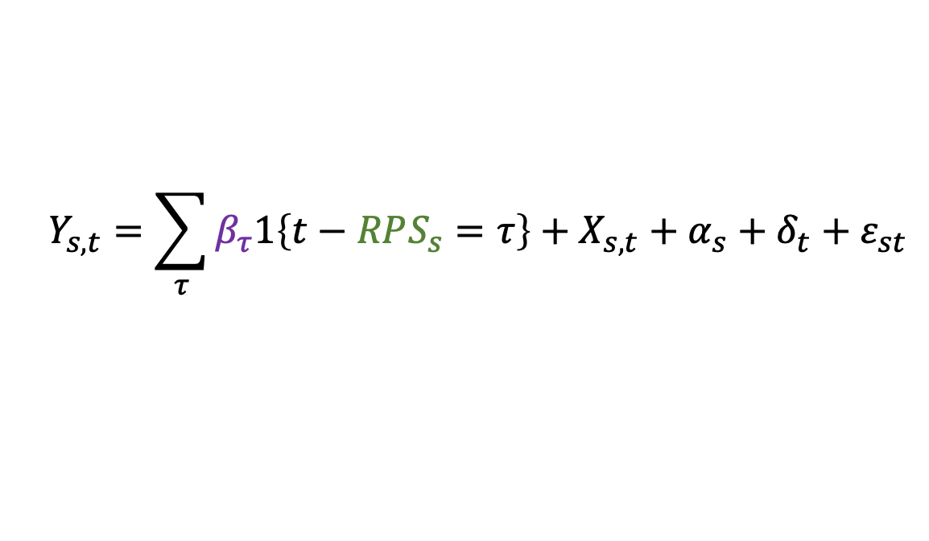
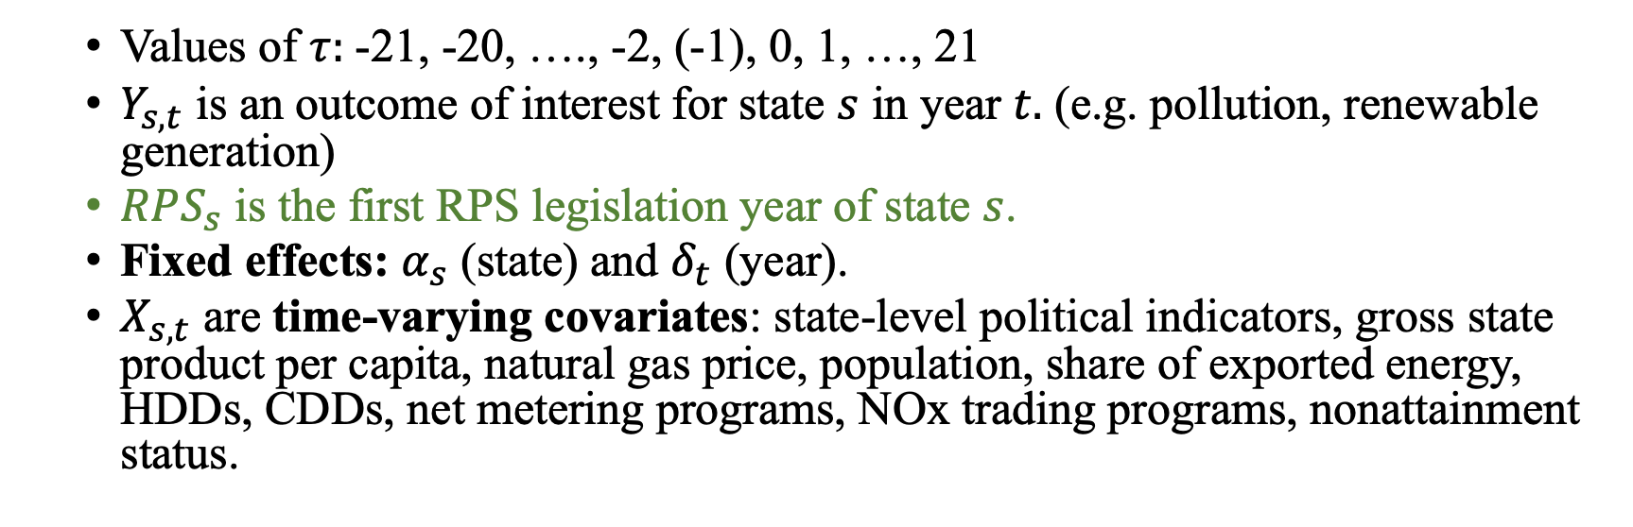
Empirical Strategy: Difference-in-Differences (DiD)
$$Y_{s,t}=\sum_{τ}{β_{τ}1\left\{t−RPS_{s}=τ\right\}+X_{s,t}+α_{s}+δ_{t}+ε_{st}}$$
Values of $τ:$-21, -20, …., -2, (-1), 0, 1, …, 21
$Y_{s,t}$ is an outcome of interest for state $s$ in year $t.$ (e.g. pollution, renewable generation)
$RPS_{s}$ is the first RPS legislation year of state $s$.
Fixed effects: $α_{s}$ (state) and $δ_{t}$ (year).
$X_{s,t}$ are time-varying covariates: state-level political indicators, gross state product per capita, natural gas price, population, share of exported energy, HDDs, CDDs, net metering programs, NOx trading programs, nonattainment status.

Slide 20
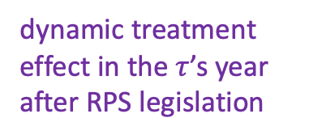
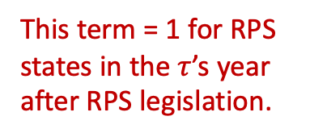
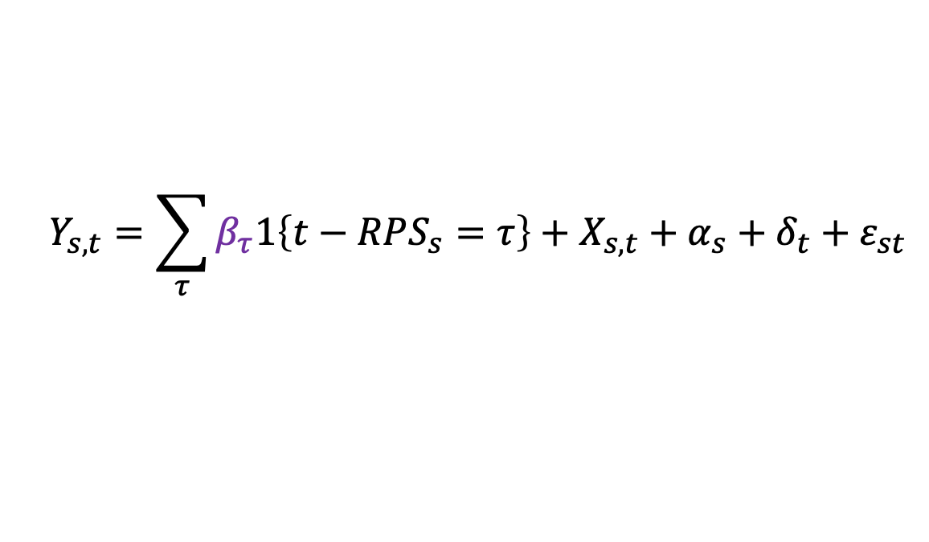
Empirical Strategy: Event Study Specification
$$Y_{s,t}=\sum_{τ}{β_{τ}1\left\{t−RPS_{s}=τ\right\}+X_{s,t}+α_{s}+δ_{t}+ε_{st}}$$
Estimator: TWFE
Difficulty in robust quasi-triple-differences inference when estimating heterogeneous treatment effects (suggestions needed)
TWFE looks similar to robust DID estimators in the baseline regression (Sun and Abraham 2021; Callaway and Sant’Anna 2022)
Identifying assumption:
Weak Parallel Trend: States that have adopted RPS would have behaved the same as states that never adopted RPS if not for RPS adoption (Marcus and Sant’Anna 2021)
dynamic treatment effect in the $τ$’s year after RPS legislation
This term = 1 for RPS states in the $τ$’s year after RPS legislation.

Slide 21
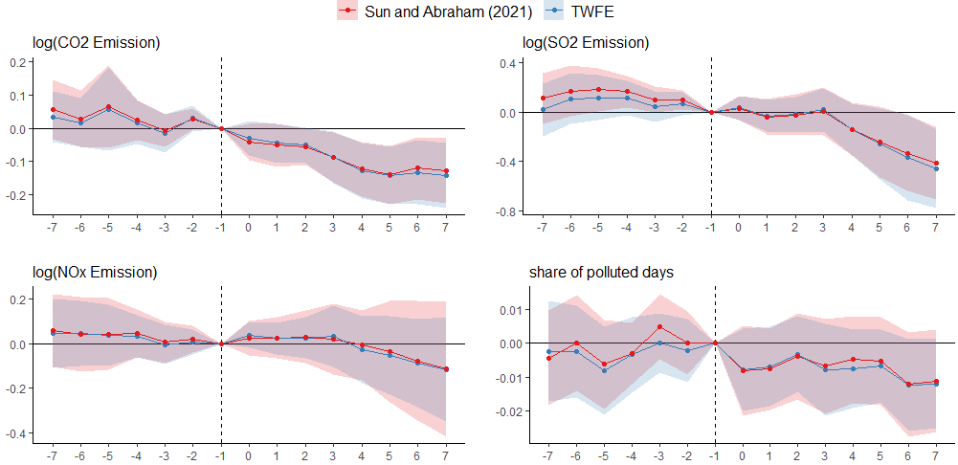
Two types of DD estimators are presented in the figure: (1) TWFE, two-way fixed effects estimated by OLS and (2) the robust DiD estimator proposed by Sun and Abraham (2021).

Slide 22
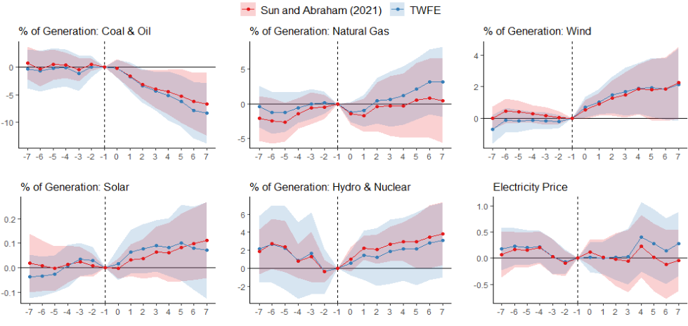

Slide 23
Outcome | Pre-trend Test |  | Power Analysis (Roth 2022)
 | Joint Significance (p-value) | Slope Coefficient (p-value) | Bayes Factor | Likelihood Ratio
log(CO2 Emission) | 0.267 | 0.764 | 0.245 | 0.002
log(SO2 Emission) | 0.097 | 0.776 | 0.236 | 0.062
log(NOx Emission) | 0.699 | 0.223 | 0.242 | 0.082
log(AQI 90p) pop-weighted | 0.17 | 0.218 | 0.255 | 0.834
log(AQI median) pop-weighted | 0 | 0.008 | 0.246 | 25.43
Polluted days pop-weighted | 0.44 | 0.069 | 0.252 | 0.247
Gen: Coal & Oil | 0.08 | 0.044 | 0.232 | 0.029
Gen: NG | 0.513 | 0.591 | 0.242 | 0.002
Gen: Wind | 0.07 | 0.032 | 0.234 | 0.206
Gen: Solar | 0.865 | 0.018 | 0.245 | 0.337
Gen: Hydro & Nuclear | 0.437 | 0.001 | 0.23 | 0.015
Electricity Price | 0.164 | 0.02 | 0.245 | 4.568
Tests: 7 pre-treatment periods (-8 to -2); 10 post-treatment periods (0 to 9) Left panel: Traditional test of level and trend significance for pre-trend significance on TWFE estimands Right panel: Roth’s (2022 AER: Insights) procedure of pre-trend power with test power =0.8. Smaller likelihood ratio: effect more likely driven by treatment Larger likelihood ratio: effect more likely driven by linear pretrend

Slide 24
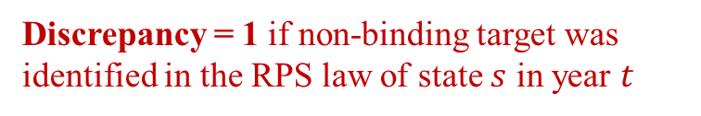
Impact of Policy Stringency in RPS Policy Design
Treatment effect of stringent RPS policy
Difference in the dynamic treatment effect due to existence of non-stringent policy design.
$$Y_{s,t}=\sum_{τ}{\left(β_{τ}+γ_{τ}×Discrepancy_{st})⋅1\left\{t−RPS_{s}=τ\right\}\right.}+X_{s,t}+α_{s}+δ_{t}+ε_{st}$$
Discrepancy = 1 if non-binding target was identified in the RPS law of state $s$ in year $t$
Discrepancy is due to any of the 4 policy designs: (1) voluntary commitment, (2) excluded sales, (3) credit multiplier, (4) carbon exemption

Slide 25
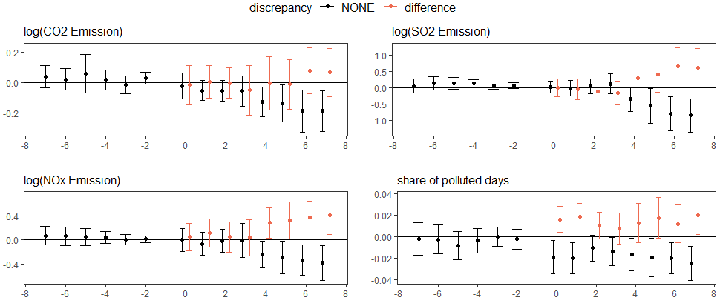
Difference in the dynamic treatment effect due to existence of non-stringent policy design.

Slide 26
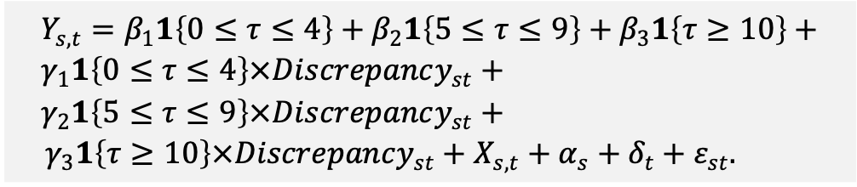
Impact of RPS Discrepancy
Following Greenstone and Nath (2022), we estimate the dynamic treatment effects summarized into 5-year periods: short-run (0-4 years), medium-run (5-9 years), long-run (>10 years).
Partially guided by the event study graph
RPS targets usually become tighter over time, some with built-in soft checks (Deschenes et al. 2023)
30% renewable by 2030. Interim goal of 15% by 2015, 18% by 2018, etc.
$$Y_{s,t}=β_{1}1\left\{0≤τ≤4\right\}+β_{2}1\left\{5≤τ≤9\right\}+β_{3}1\left\{τ≥10\right\}+ \\ γ_{1}1\left\{0≤τ≤4\right\}×Discrepancy_{st}+ \\ γ_{2}1\left\{5≤τ≤9\right\}×Discrepancy_{st}+$$ ${ γ}_{3}1\left\{τ≥10\right\}×Discrepancy_{st}+X_{s,t}+α_{s}+δ_{t}+ε_{st}.$

Slide 27
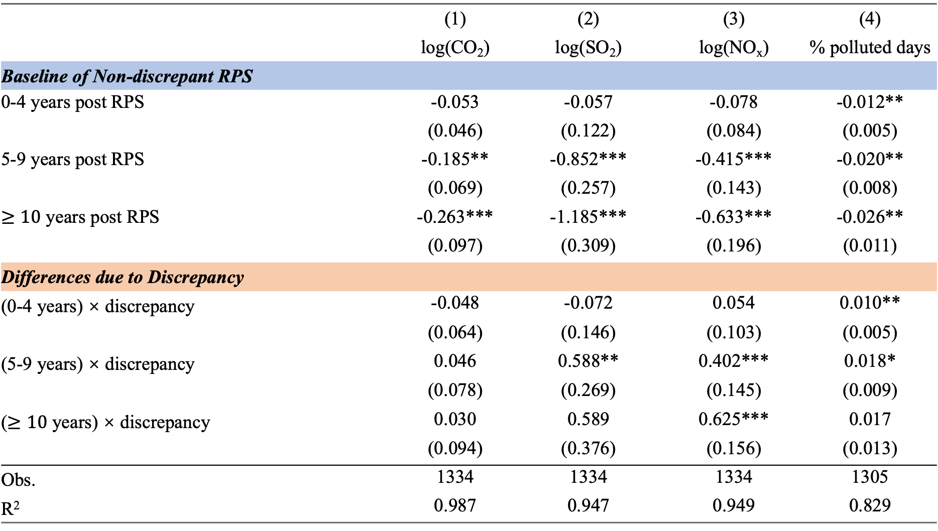
 | (1) | (2) | (3) | (4)
 | log(CO₂) | log(SO₂) | log(NO_{x}) | % polluted days
Baseline of Non-discrepant RPS
0-4 years post RPS | -0.053 | -0.057 | -0.078 | -0.012**
 | (0.046) | (0.122) | (0.084) | (0.005)
5-9 years post RPS | -0.185** | -0.852*** | -0.415*** | -0.020**
 | (0.069) | (0.257) | (0.143) | (0.008)
$≥10$ years post RPS | -0.263*** | -1.185*** | -0.633*** | -0.026**
 | (0.097) | (0.309) | (0.196) | (0.011)
Differences due to Discrepancy
(0-4 years) × discrepancy | -0.048 | -0.072 | 0.054 | 0.010**
 | (0.064) | (0.146) | (0.103) | (0.005)
(5-9 years) × discrepancy | 0.046 | 0.588** | 0.402*** | 0.018*
 | (0.078) | (0.269) | (0.145) | (0.009)
($≥10$ years) × discrepancy | 0.030 | 0.589 | 0.625*** | 0.017
 | (0.094) | (0.376) | (0.156) | (0.013)
Obs. | 1334 | 1334 | 1334 | 1305
R² | 0.987 | 0.947 | 0.949 | 0.829
Standard errors are clustered at the state level. ***, **, * indicate statistical significance at 1%, 5% and 10%, respectively.

Slide 28
Headline Impact
For clean RPS laws, in the medium run (5-9 years):
CO₂ decreases by 16.6%
SO₂ decreases by 56.7%
NO_{x} decreases by 33.2%
% Polluted days decrease by 2.0 pp
For dirty RPS laws:
CO₂ decreases by 12.5%
SO₂ decreases by 21.8%
NO_{x} decreases by 0%
% Polluted days decrease by 0.2 pp

Slide 29
What is driving the observed divergence?
Clean RPS laws lead to:
Quick transition away from coal and oil generation
Driving the environmental performance of the clean RPS laws
Partially compensated by faster growth in natural gas generation
Small increase in solar generation
Dirty RPS laws:
Slower transition away from coal and oil generation (but still faster than non-RPS states)
Small increase in wind generation

Slide 30
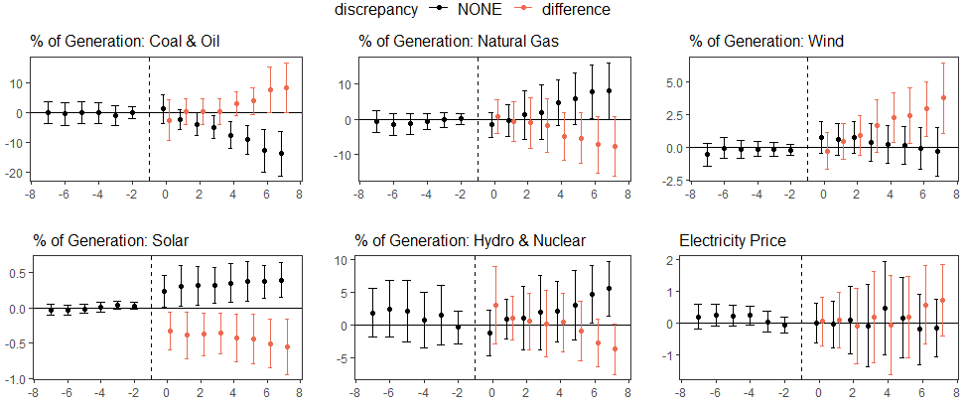
Difference in the dynamic treatment effect due to existence of non-stringent policy design.

Slide 31
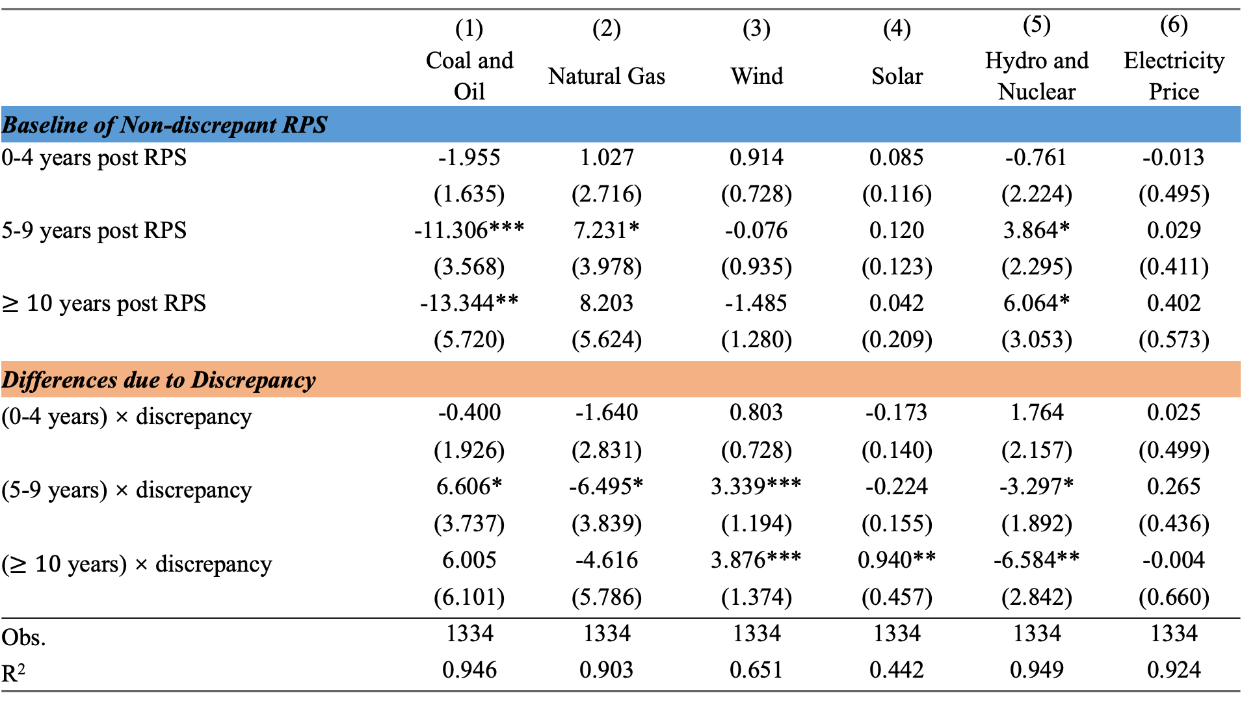
 | (1) | (2) | (3) | (4) | (5) | (6)
 | Coal and Oil | Natural Gas | Wind | Solar | Hydro and Nuclear | Electricity Price
Baseline of Non-discrepant RPS
0-4 years post RPS | -1.955 | 1.027 | 0.914 | 0.085 | -0.761 | -0.013
 | (1.635) | (2.716) | (0.728) | (0.116) | (2.224) | (0.495)
5-9 years post RPS | -11.306*** | 7.231* | -0.076 | 0.120 | 3.864* | 0.029
 | (3.568) | (3.978) | (0.935) | (0.123) | (2.295) | (0.411)
$≥10$ years post RPS | -13.344** | 8.203 | -1.485 | 0.042 | 6.064* | 0.402
 | (5.720) | (5.624) | (1.280) | (0.209) | (3.053) | (0.573)
Differences due to Discrepancy
(0-4 years) × discrepancy | -0.400 | -1.640 | 0.803 | -0.173 | 1.764 | 0.025
 | (1.926) | (2.831) | (0.728) | (0.140) | (2.157) | (0.499)
(5-9 years) × discrepancy | 6.606* | -6.495* | 3.339*** | -0.224 | -3.297* | 0.265
 | (3.737) | (3.839) | (1.194) | (0.155) | (1.892) | (0.436)
($≥10$ years) × discrepancy | 6.005 | -4.616 | 3.876*** | 0.940** | -6.584** | -0.004
 | (6.101) | (5.786) | (1.374) | (0.457) | (2.842) | (0.660)
Obs. | 1334 | 1334 | 1334 | 1334 | 1334 | 1334
R² | 0.946 | 0.903 | 0.651 | 0.442 | 0.949 | 0.924

Slide 32
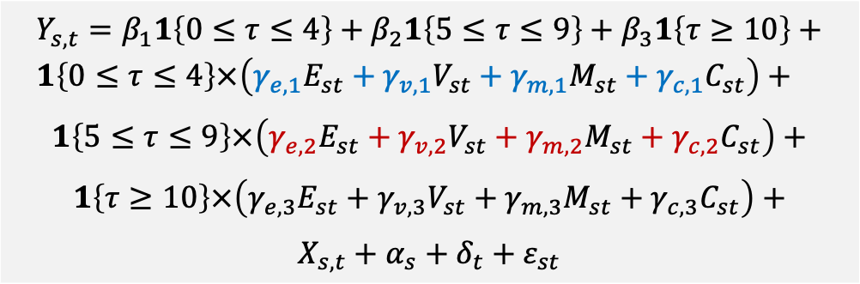
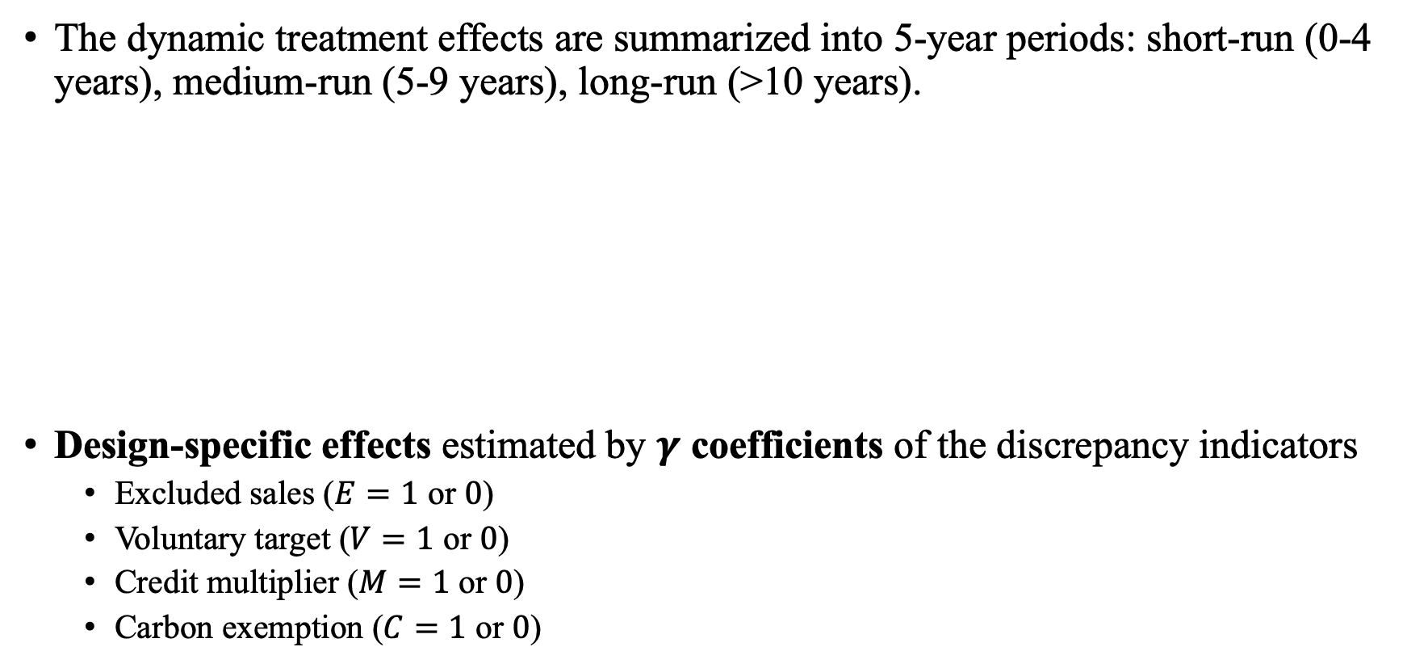
Decomposing “policy design” effect through 4 types of discrepancies
The dynamic treatment effects are summarized into 5-year periods: short-run (0-4 years), medium-run (5-9 years), long-run (>10 years).
Design-specific effects estimated by $γ$ coefficients of the discrepancy indicators
Excluded sales ($E=1$ or $0$)
Voluntary target ($V=1$ or $0$)
Credit multiplier ($M=1$ or $0$)
Carbon exemption ($C=1$ or $0$)
$$Y_{s,t}=β_{1}1\left\{0≤τ≤4\right\}+β_{2}1\left\{5≤τ≤9\right\}+β_{3}1\left\{τ≥10\right\}+ \\ 1\left\{0≤τ≤4\right\}×\left(γ_{e,1}E_{st}+γ_{v,1}V_{st}+γ_{m,1}M_{st}+γ_{c,1}C_{st}\right)+$$
$$1\left\{5≤τ≤9\right\}×\left(γ_{e,2}E_{st}+γ_{v,2}V_{st}+γ_{m,2}M_{st}+γ_{c,2}C_{st}\right)+$$
$$1\left\{τ≥10\right\}×\left(γ_{e,3}E_{st}+γ_{v,3}V_{st}+γ_{m,3}M_{st}+γ_{c,3}C_{st}\right)+$$
$$X_{s,t}+α_{s}+δ_{t}+ε_{st}$$

Slide 33
 | log(CO₂) | log(SO₂) | log(NO_{x}) | % polluted days
0-4 years post RPS | -0.099* | -0.123 | -0.088 | -0.011**
 | (0.050) | (0.097) | (0.076) | (0.005)
5-9 years post RPS | -0.229*** | -0.819*** | -0.347*** | -0.021**
 | (0.063) | (0.242) | (0.126) | (0.008)
ATT Differences due to RPS Law Discrepancy: 0-4 years post RPS
(0-4 years) × exclude | 0.110 | 0.146 | 0.196* | 0.013**
 | (0.077) | (0.130) | (0.107) | (0.006)
(0-4 years) × voluntary | -0.224 | -0.255* | -0.008 | 0.000
 | (0.160) | (0.138) | (0.108) | (0.007)
(0-4 years) × multiplier | -0.017 | 0.024 | -0.087 | -0.005
 | (0.050) | (0.186) | (0.119) | (0.008)
(0-4 years) × carbon | 0.080 | 0.097 | -0.026 | 0.007
 | (0.109) | (0.163) | (0.106) | (0.009)
ATT Differences due to RPS Law Discrepancy: 5-9 years post RPS
(5-9 years) × exclude | 0.174** | 0.538* | 0.382** | 0.024*
 | (0.074) | (0.302) | (0.156) | (0.012)
(5-9 years) × voluntary | -0.194* | 0.013 | 0.022 | 0.002
 | (0.103) | (0.358) | (0.307) | (0.012)
(5-9 years) × multiplier | -0.006 | 0.310 | -0.053 | -0.003
 | (0.074) | (0.241) | (0.142) | (0.011)
(5-9 years) × carbon | 0.107 | 0.164 | 0.180 | 0.011
 | (0.089) | (0.220) | (0.136) | (0.011)
Obs. | 1334 | 1334 | 1334 | 1305
R² | 0.988 | 0.949 | 0.948 | 0.831
Standard errors are clustered at the state level. ***, **, * indicate statistical significance at 1%, 5% and 10%, respectively.

Slide 34
 | Coal & Oil | Natural Gas | Hydro & Nuclear | Wind | Solar | Electricity Price
0-4 years post RPS | -3.111** | 1.858 | 0.3210 | 0.475 | 0.028 | -0.038
 | (1.408) | (2.555) | (1.882) | (0.652) | (0.068) | (0.400)
5-9 years post RPS | -11.624*** | 8.026* | 4.695** | -1.173 | 0.117 | 0.023
 | (3.480) | (4.005) | (2.246) | (0.979) | (0.114) | (0.399)
ATT Differences due to RPS Law Discrepancy: 0-4 years post RPS
(0-4 years) × exclude | 2.097 | -3.574 | -1.301 | 2.931*** | -0.162 | 0.214
 | (1.789) | (2.569) | (2.240) | (0.909) | (0.162) | (0.505)
(0-4 years) × voluntary | -0.945 | -0.442 | 2.349 | -0.632 | 0.051 | 0.096
 | (1.913) | (2.760) | (1.949) | (1.273) | (0.089) | (0.439)
(0-4 years) × multiplier | -0.570 | 1.329 | 0.2979 | -1.664** | 0.082 | -0.627*
 | (1.677) | (2.184) | (1.494) | (0.739) | (0.167) | (0.357)
(0-4 years) × carbon | -3.081 | 0.644 | 1.746 | 1.207* | 0.142 | 0.083
 | (2.831) | (2.934) | (1.352) | (0.640) | (0.108) | (0.574)
ATT Differences due to RPS Law Discrepancy: 5-9 years post RPS
(5-9 years) × exclude | 7.728** | -8.774** | -5.976** | 7.058*** | -0.218 | 0.492
 | (3.817) | (3.678) | (2.600) | (1.889) | (0.227) | (0.541)
(5-9 years) × voluntary | 0.738 | -1.915 | 0.0241 | 1.644 | -0.260** | 0.052
 | (4.645) | (5.150) | (2.484) | (3.455) | (0.112) | (0.285)
(5-9 years) × multiplier | 2.198 | 0.568 | 1.141 | -4.910** | 0.171 | -0.831
 | (3.605) | (3.558) | (2.453) | (1.971) | (0.272) | (0.495)
(5-9 years) × carbon | -2.130 | -0.358 | -1.238 | 3.933** | 0.009 | 0.633
 | (3.742) | (3.996) | (1.682) | (1.760) | (0.126) | (0.635)
Obs. | 1334 | 1334 | 1334 | 1334 | 1334 | 1334
R² | 0.949 | 0.907 | 0.965 | 0.698 | 0.477 | 0.930
Standard errors are clustered at the state level. ***, **, * indicate statistical significance at 1%, 5% and 10%, respectively.

Slide 35
Monetizing environmental impacts of discrepancy
So what are the monetary impacts of the observed environmental gap?
Problem: Air pollution transports and disperses over political boundaries
Solution: EPA’s CO-Benefits Risk Assessment (COBRA) tool：
Integrates a pollutant fate and transport model with monetized exposure estimates
Allows counterfactual analysis at the state/sector level

Slide 36
Example
Arizona has discrepant RPS laws passed in 2001 and 2006
Counterfactual prediction: Clean RPS laws would have led to
44.6% lower SO₂ emission from electricity generation
33.1% lower NO₂ emission
With a 3% discount rate, this would lead to $171-385 million of foregone environmental co-benefit
Mostly from cost of mortality: $167-380 million

Slide 37
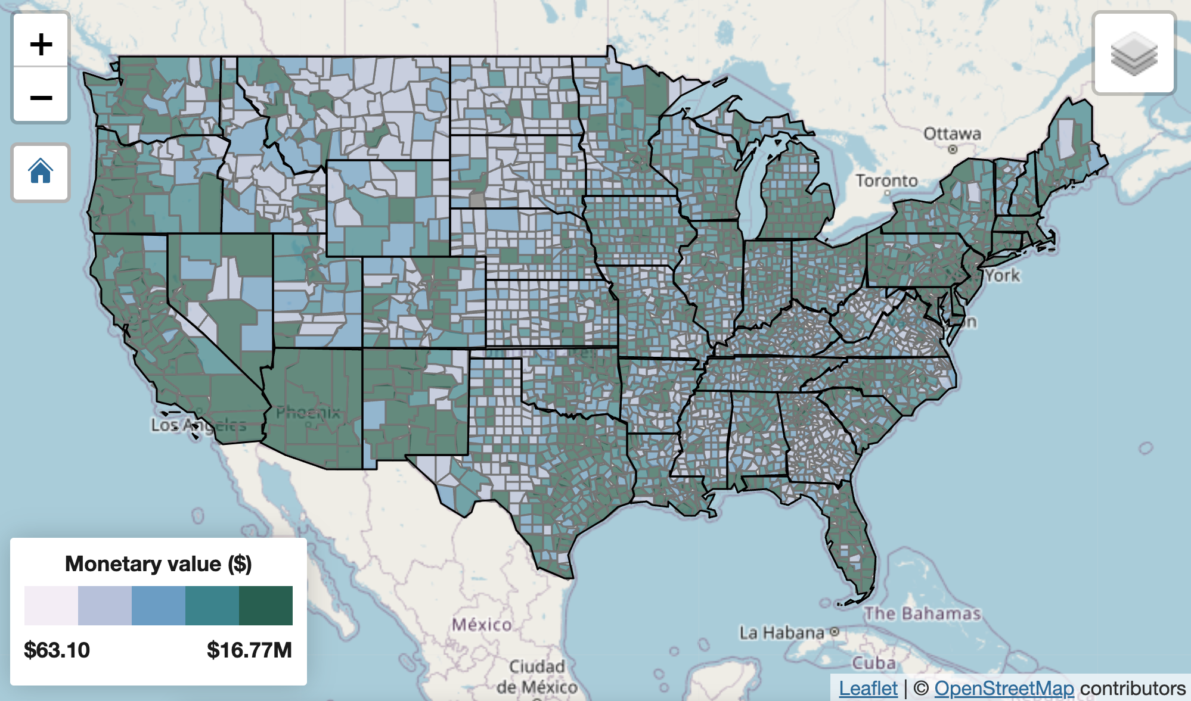

Slide 38
National Estimate of Foregone Co-benefits
Baseline year: 2016
19 states have passed discrepant RPS for at least 5 years: AZ, CA, CO, CT, DE, IL, IN, KS, MA, MD, ME, MI, MO, NM, NV, PA, UT, VA, WA
Medium-run estimate on foregone pollution reduction: 44.6% SO₂, 33.1% NO₂ emission
Monetized foregone co-benefit: $5.83-13.13 billion in 2016
38% of the total RPS co-benefits
10-30% of the additional social cost from increased electricity prices (Greenstone and Nath, 2021 NBER WP)
Close in magnitude to engineering simulation studies (e.g., Barbose et al. 2016 ERL)

Slide 39
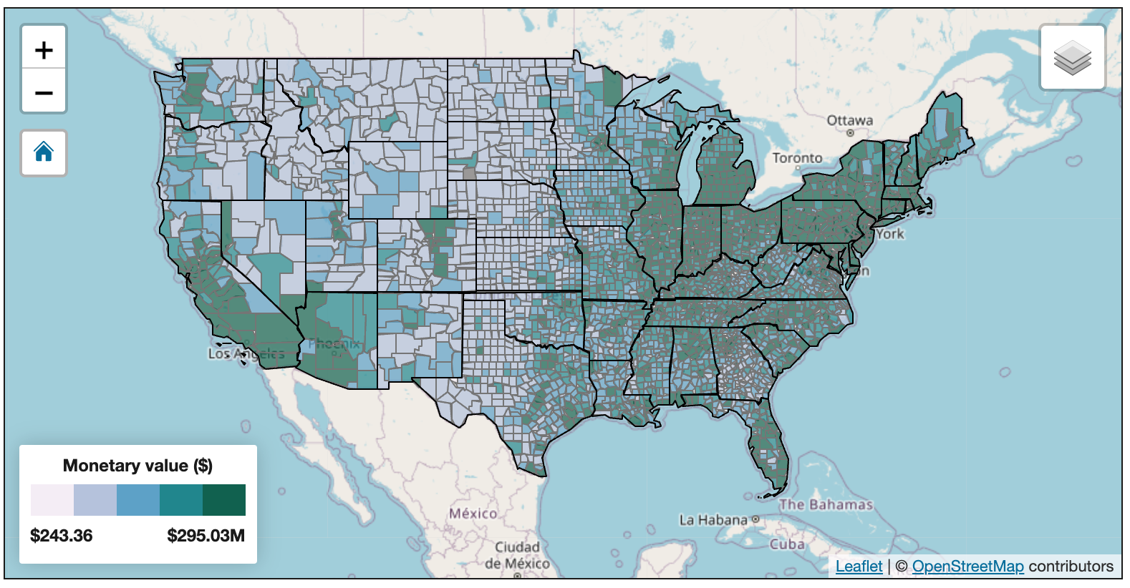

Slide 40
Conclusions
Stringency of the law could substantially affect the RPS policy outcomes.
Discrepancies in RPS laws in general undermine the intended RPS policy effects.
Less reduction in non-CO2 pollutants (SO2, NOx)
Less improvement in air quality
Smaller cuts in coal & oil generation
Lower growth in natural gas
Less generation from solar, but more generation from wind.
The discrepancy policy design in “excluded sales” is most influential in altering the RPS effects.

Slide 41
Supplementary Slides

Slide 42
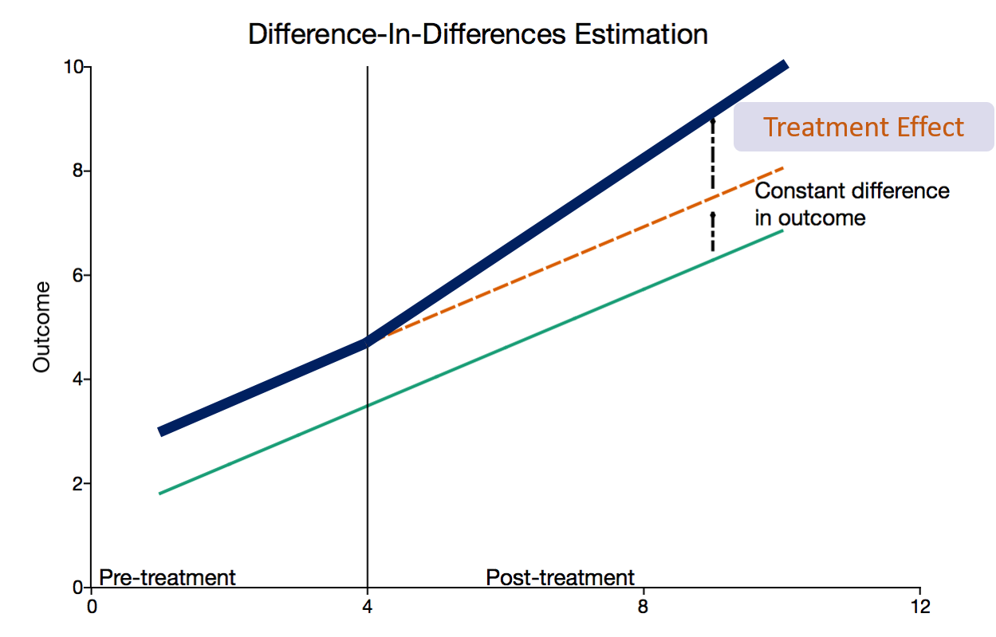
Difference-in-Differences to identify policy effect
Source: https://www.aptech.com/blog/introduction-to-difference-in-differences-estimation/

Slide 43
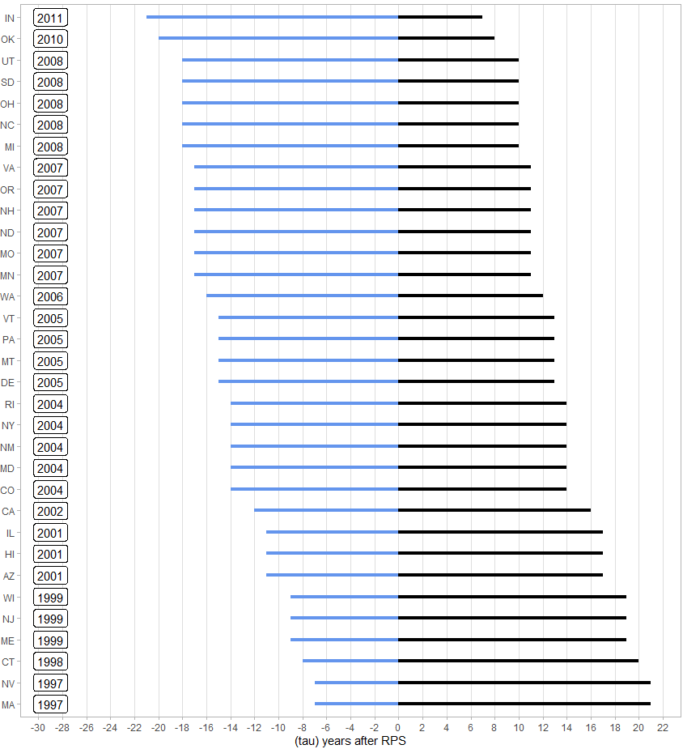
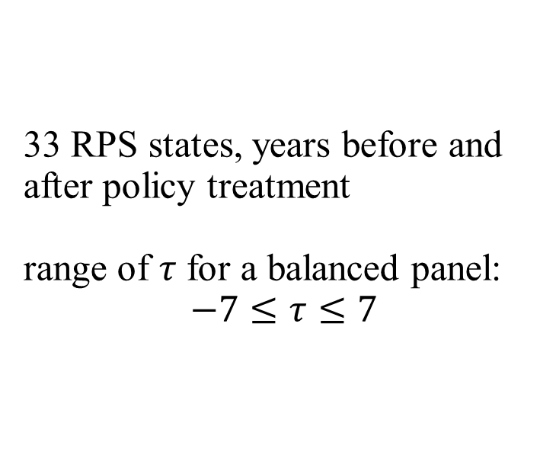
33 RPS states, years before and after policy treatment range of $τ$ for a balanced panel: $$−7≤τ≤7$$

Slide 44
Panel A: Outcome Variables
 | RPS states |  |  | Control states
 | N | Mean (std dev) | Min-Max | N | Mean (std dev) | Min-Max
CO2 (1000 metric tons) | 957 | 37463.239 (32870.971) | 6.583 – 133416.545 | 377 | 46490.424 (32388.933) | 438.133 – 131543.37
SO2 (1000 metric tons) | 957 | 164.228 (283.856) | 0.009 – 2045.983 | 377 | 201.061 (224.377) | 2.559 – 892.347
NOx (1000 metric tons) | 957 | 78.616 (92.709) | 0.148 – 535.619 | 377 | 95.194 (87.313) | 1.931 – 353.547
Share of Polluted Days | 957 | 0.051 (0.056) | 0.000 – 0.369 | 348 | 0.033 (0.037) | 0.000 – 0.194
% of Generation: Coal and Oil | 957 | 46.141 (30.604) | 0.033 – 96.964 | 377 | 47.48 (27.229) | 0.112 – 97.564
% of Generation: Natural Gas | 957 | 18.866 (22.573) | 0.000 – 98.944 | 377 | 19.664 (21.824) | 0.028 – 79.666
% of Generation: Wind | 957 | 1.910 (4.551) | 0.000 – 32.230 | 377 | 0.815 (2.803) | 0.000 – 18.478
% of Generation: Solar | 957 | 0.239 (1.105) | 0.000 – 13.806 | 377 | 0.039 (0.248) | 0.000 – 3.059
% of Generation: Other Renewables | 957 | 14.663 (20.977) | 0.000 – 91.360 | 377 | 13.004 (21.678) | 1.258 – 98.284
Electricity Price (cents per kWh, 2015 USD) | 957 | 10.510 (3.563) | 5.098 – 34.040 | 377 | 8.442 (2.291) | 5.099 – 17.726

Slide 45
Panel B: State-level Time-varying Covariates
 | RPS states |  |  | Control states
 | N | Mean (std dev) | Min-Max | N | Mean (std dev) | Min-Max
Legislature control (DEM) | 957 | 0.417 (0.493) | 0 – 1 | 377 | 0.337 (0.473) | 0 – 1
Legislature control (GOP) | 957 | 0.336 (0.473) | 0 – 1 | 377 | 0.451 (0.498) | 0 – 1
State control (DEM) | 957 | 0.229 (0.42) | 0 – 1 | 377 | 0.172 (0.378) | 0 – 1
State control (GOP) | 957 | 0.231 (0.422) | 0 – 1 | 377 | 0.334 (0.472) | 0 – 1
Governing party (DEM) | 957 | 0.486 (0.495) | 0 – 1 | 377 | 0.377 (0.48) | 0 – 1
Log(Gross State Product) | 957 | 11.854 (1.139) | 9.351 – 14.817 | 377 | 11.546 (0.923) | 9.45 –13.737
Natural Gas Price ($ per 1000 ft3) | 957 | 6.126 (3.017) | 2.005 –32.39 | 377 | 5.433 (2.129) | 0.479 –11.428
Log(Population) | 957 | 15.132 (1.036) | 13.244 –17.491 | 377 | 14.931 (0.942) | 13.025 –16.872
Net Metering Program | 957 | 0.639 (0.48) | 0 – 1 | 377 | 0.342 (0.475) | 0 – 1
% of Energy Exported | 957 | 0.089 (0.447) | -0.840 – 2.737 | 377 | 0.169 (0.576) | -0.636 – 2.607
HDDs | 957 | 5642.92 (2019.611) | 0 – 10810 | 377 | 4317.859 (2757.045) | 430 – 11702
CDDs | 957 | 935.448 (896.818) | 42 – 5213 | 377 | 1550.968 (963.582) | 0 – 4156
NOx Trading Program | 957 | 0.088 (0.283) | 0 – 1 | 377 | 0.064 (0.244) | 0 – 1

